Slide 1
History of Cryptography
Name : Jeevan S U
Roll No:241059038
Program: M.E – Cyber Security,
MSIS, MAHE

Slide 2
Cryptography and Security Basics

Slide 3
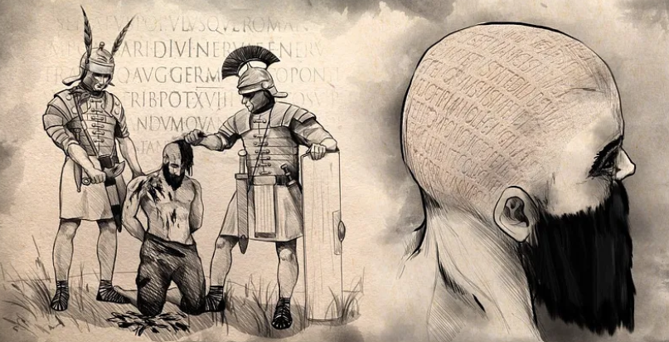
Origins of Cryptography
Steganography (hiding the message)
Used for 2000 years
Examples: invisible ink, SHAVED HEAD!
Huge security issues – led to the development of cryptography (hiding the meaning)

Slide 4
Cryptography
Cryptography is the science concerned with secret communication.
Gives us a way to provide formal guarantees in the presence of a third party, or adversary.
Cryptography lets us communicate securely using insecure channels (i.e. the Internet).

Slide 5
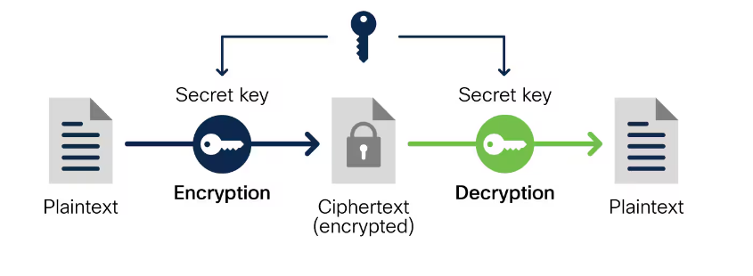
Encryption
Encryption is the process of hiding information from everybody except those that have the key.
Think: Encryption is simply a component, or direct application, of Cryptography.

Slide 6
Ciphers
Cipher: each letter in a phrase is replaced by another letter, number, or symbol
Plain text: the message
Cipher text: the encrypted message
Transposition: each letter retains its identity but changes its position
Substitution: each letter changes its identity but retains its position

Slide 7
An Analogy
Codemakers : codebreakers : : antibiotic : bacteria

Slide 8
Historical Examples
“Practically since humans began writing, they have been writing in code…”

Slide 9
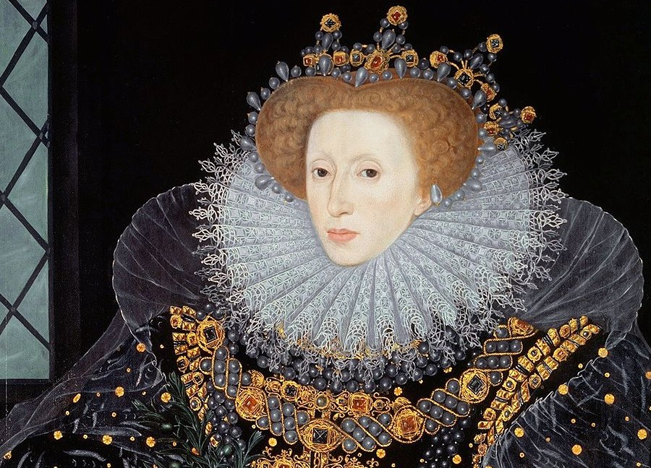
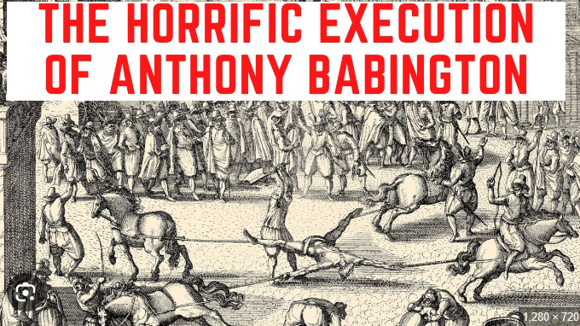
The Babington Plot (1586)

Slide 10
Objective: Assassinate Queen Elizabeth I and replace her with Mary, Queen of Scots, to restore Catholicism in England.
Key Figures:
Elizabeth I: Protestant Queen of England
Mary, Queen of Scots: Catholic cousin, imprisoned in England since 1568
Anthony Babington: Young conspirator
John Ballard: Jesuit priest and recruiter
Robert Poley and Gilbert Gifford: Double agents
Thomas Phelippes: Spy and cryptanalyst
Discovery: Plot uncovered by Sir Francis Walsingham using double agents and intercepted communications.

Slide 11
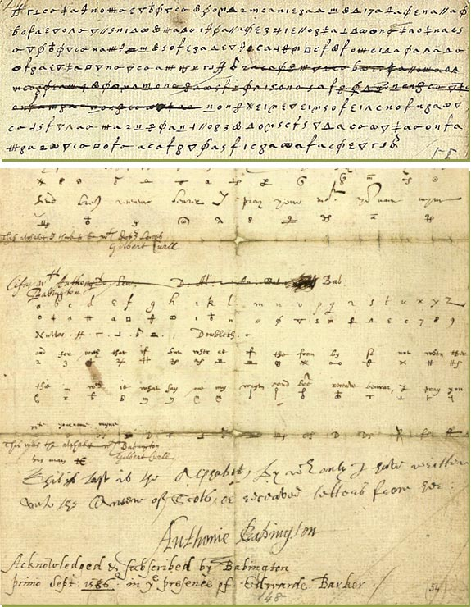
Outcome of the Babington Plot
Critical Letter: Mary’s response (17 July 1586) ordered the assassination of Elizabeth.
Trial and Execution:
Trial Date: October 1586
Mary's Execution: 8 February 1587
Impact:
Increased security measures in England
Heightened tensions between Catholics and Protestants

Slide 12
Arab Cryptanalysis: A Golden Age
Arab scholars invented cryptanalysis, the science of unscrambling a message without knowledge of the key
Frequency Analysis: based on observation that some letters in a document more common than others

Slide 13
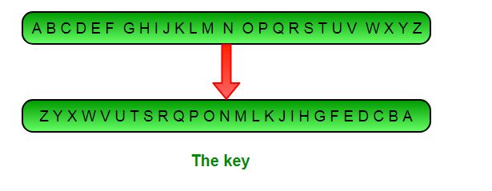
Meanwhile in Europe...
Between 800 and 1200, Europe was stuck in the Dark Ages
Only monks really studied secret writing, in order to discover hidden meanings in the Bible

Slide 14
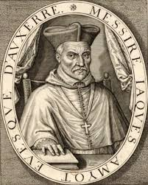
Some Progress
Monks begin to share their knowledge, and cryptography also began to blossom around the Renaissance
A few major shifts: Monoalphabetic -> polyalphabetic -> Homophonic substitution cipher
Example: Philibert Babou

Slide 15
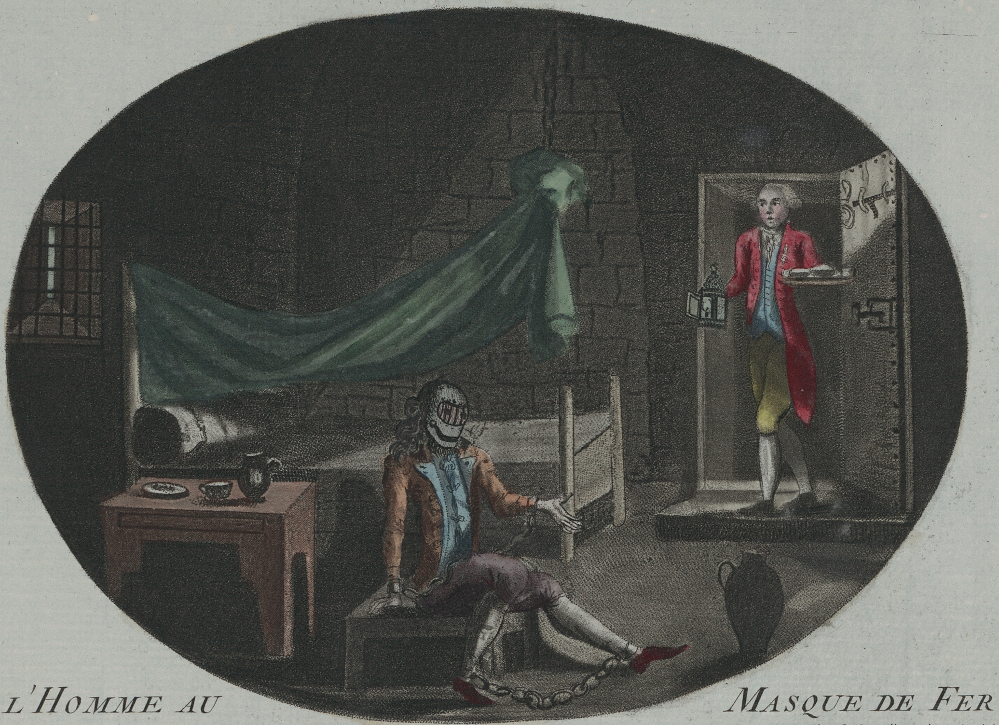
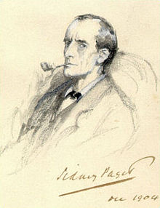
Cryptographic Advancements
Cryptography becomes more well-known and industrialized

Slide 16
A New Concept
One-Time Pad
Based on the idea of true randomness—generate a key, use it once, then throw it out
If certain conditions are met, this cipher is theoretically unbreakable.

Slide 17
Modern Cryptography

Slide 18
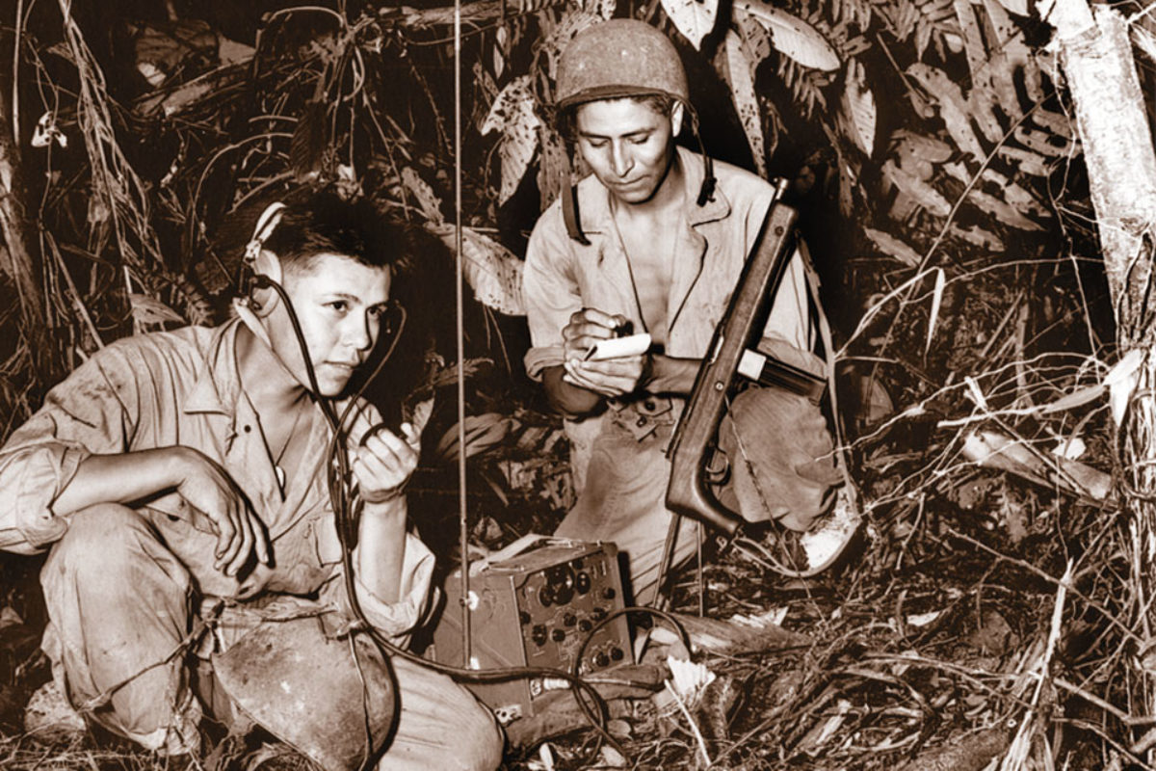
World War II (Code Talkers)

Slide 19
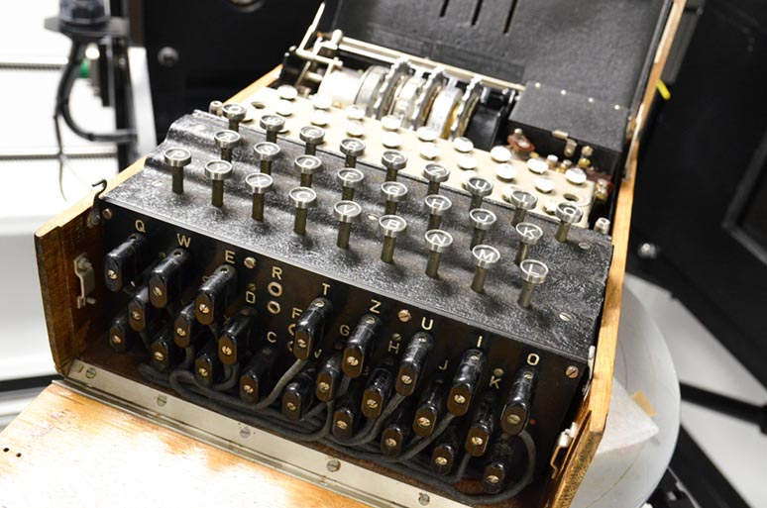
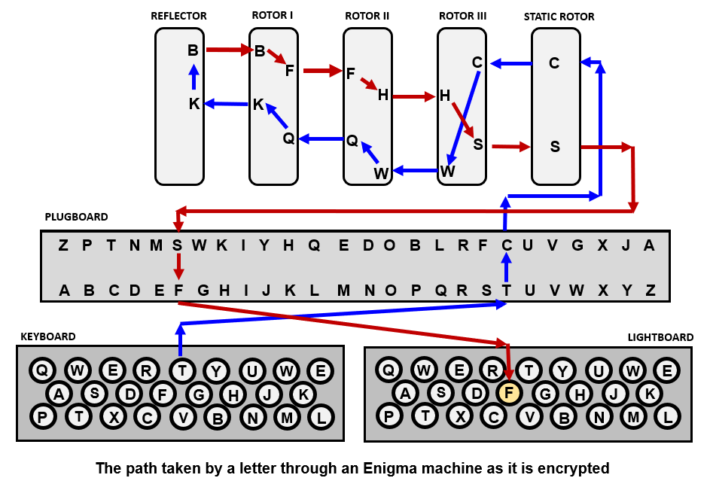
The Enigma (World War II)

Slide 20

Cracking the Enigma
Alan Turing, Father of Computer Science
Featured in
The Imitation Game!

Slide 21
Encryption Methods and Attacks

Slide 22
Symmetric-Key Cryptography
Symmetric-key Cryptography
The same secret key is used by both endpoints of communication.
The same key is used to both encrypt and decrypt.
One-time pad is an example!

Slide 23
Symmetric-Key Cryptography
In order for symmetric-key cryptography to work, both members communicating must know the secret key!
Why is this a problem?

Slide 24
Public-Key (Asymmetric) Cryptography
Public-key cryptography
The sender and receiver use different keys
Every participant has both a public key and a private key.
If Bob wants to communicate with Alice, Bob would encrypt the message with Alice’s public key, and Alice would decrypt the message with her private key.

Slide 25
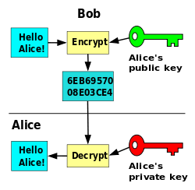
Public-Key (Asymmetric) Cryptography

Slide 26
An Example: RSA
RSA Encryption is a public-key cryptographic algorithm.
The name derives from its creators, Rivest, Shamir, and Adleman.
RSA is based on the fact that finding the factors of an integer is very difficult (a.k.a computationally expensive).

Slide 27
An Example: RSA
N = p * q
Bob’s public key N used to encrypt the message
Bob uses private key, based on p and q, used to decrypt the message

Slide 28
What makes RSA so powerful?
When N is a very large number, it is essentially impossible to factor it and figure out which primes were used to create it
In fact, this lies in a class of problems known as NP. Technically it is in the intersection of NP and co-NP.

Slide 29

What makes RSA so powerful?
When N is a very large number, it is essentially impossible to factor it and figure out which primes were used to create it
In fact, this lies in a class of problems known as NP

Slide 30
Quantum Computing
However, there is one real threat to the security of RSA
Current computers must complete tasks sequentially — each bit must be either a 0 or 1.
Quantum bits, or qubits, can exist in a state of superposition
Google says that its 54-qubit Sycamore processor was able to perform a calculation in 200 seconds that would have taken the world’s most powerful supercomputer 10,000 years. That would mean the calculation, which involved generated random numbers, is essentially impossible on a traditional, non-quantum computer.

Slide 31
What does the Future Hold?
History, as you now see, has been a constant battle between cryptographers (the makers) and cryptanalysts (the breakers).
Famous rulers, warriors, and inventors often get the credit for shaping history, but cryptography has played a huge political and social role throughout human existence

Slide 32
What does the Future Hold?
What are the implications of quantum computing?
Certainly a win for the codebreakers, but surprisingly, the biggest win will end up being for the codemakers: a perfect encryption

Slide 33
References
The Code Book : The secret history of codes and code-breaking : Simon Singh
Google confirms ‘quantum supremacy’ breakthrough - The Verge

